Slide 1

OSS Part 1
Presentation
Term Project
23102003 Kim Doyi
23102009 Park Shinhyung
23102015 Oh Eunyoung
23102025 Lee Haneol
23102031 Hwang Yuyoung

Slide 2
CONTENT
OSS Community Analysis
01
Project Proposal
02

Slide 3


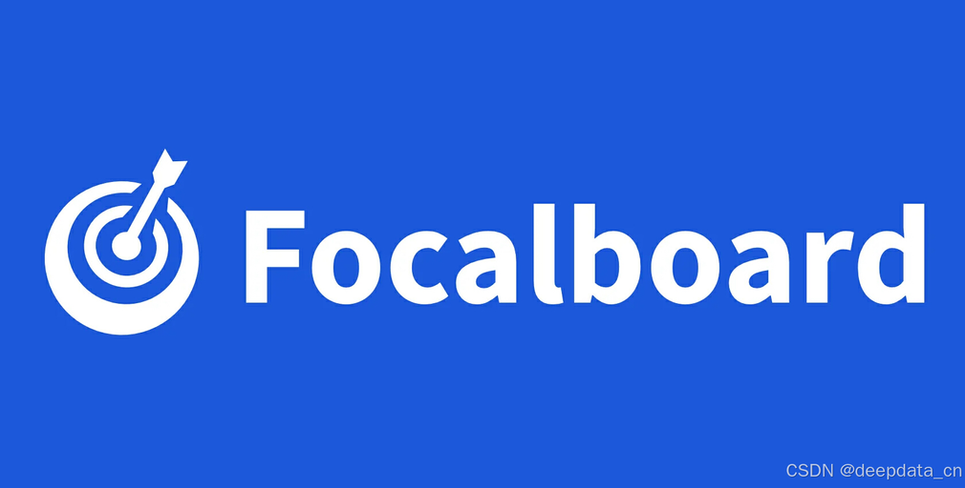

1-1. Open Source Project
Team collaboration platform
UI components platform
Project management and task tracking tool
Game engine platform
Notes:
각 오픈소스 소개, 선정 이유 설명

Slide 4

1-2. Evaluation Criteria
① Community Activity
④ Documentation Quality
② Inclusivity and Support
Open
Source
⑤ Licensing and Contribution Agreements
③ Commercial Orientation
Notes:
평가 기준 설명

Slide 5
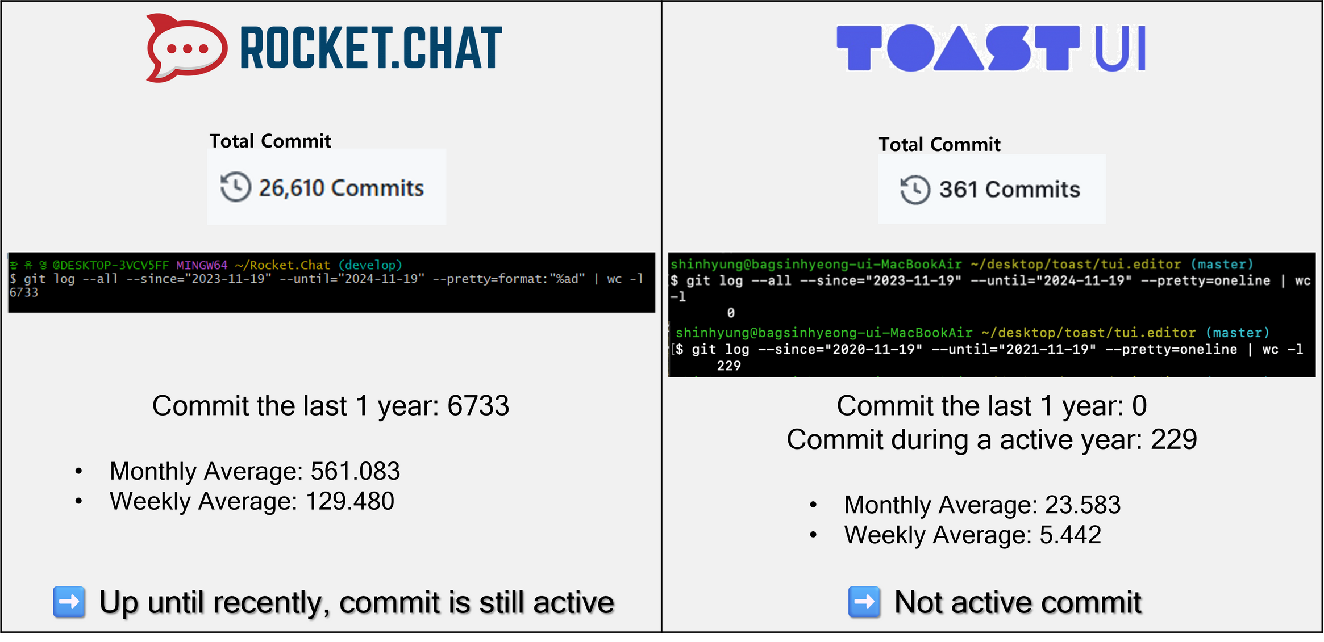
1-3. Analysis for
Community Activity
Commit Frequency

Slide 6
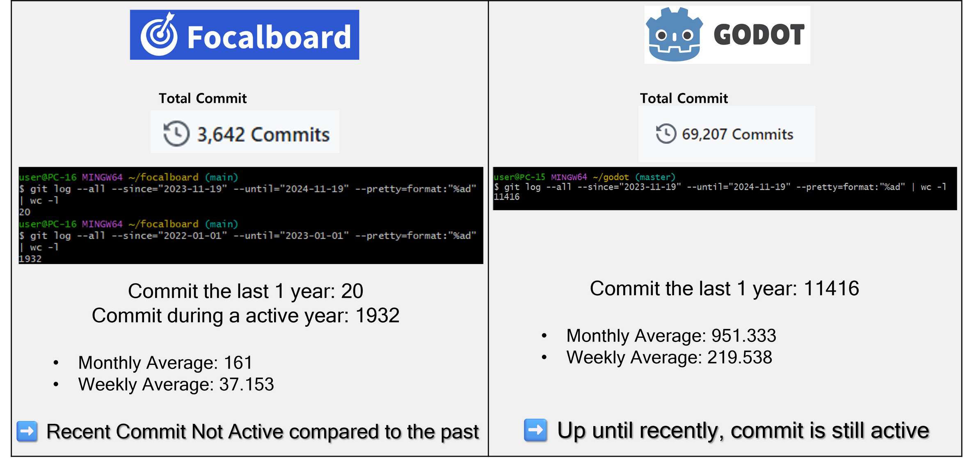
1-3. Analysis for
Community Activity
Commit Frequency

Slide 7
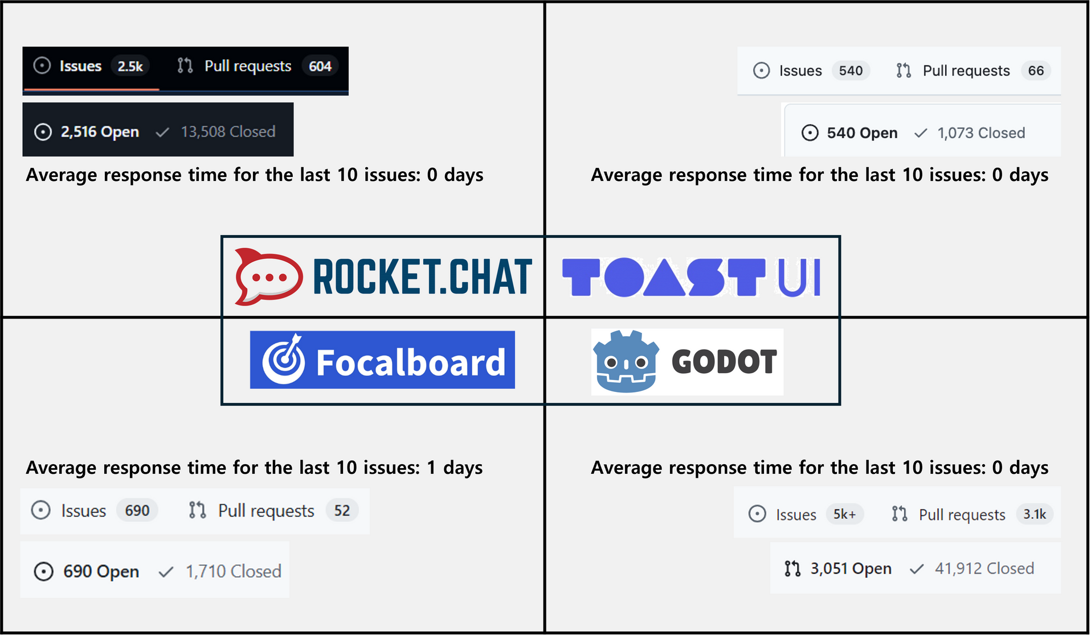
1-3. Analysis for
Community Activity
Issue Response Time

Slide 8
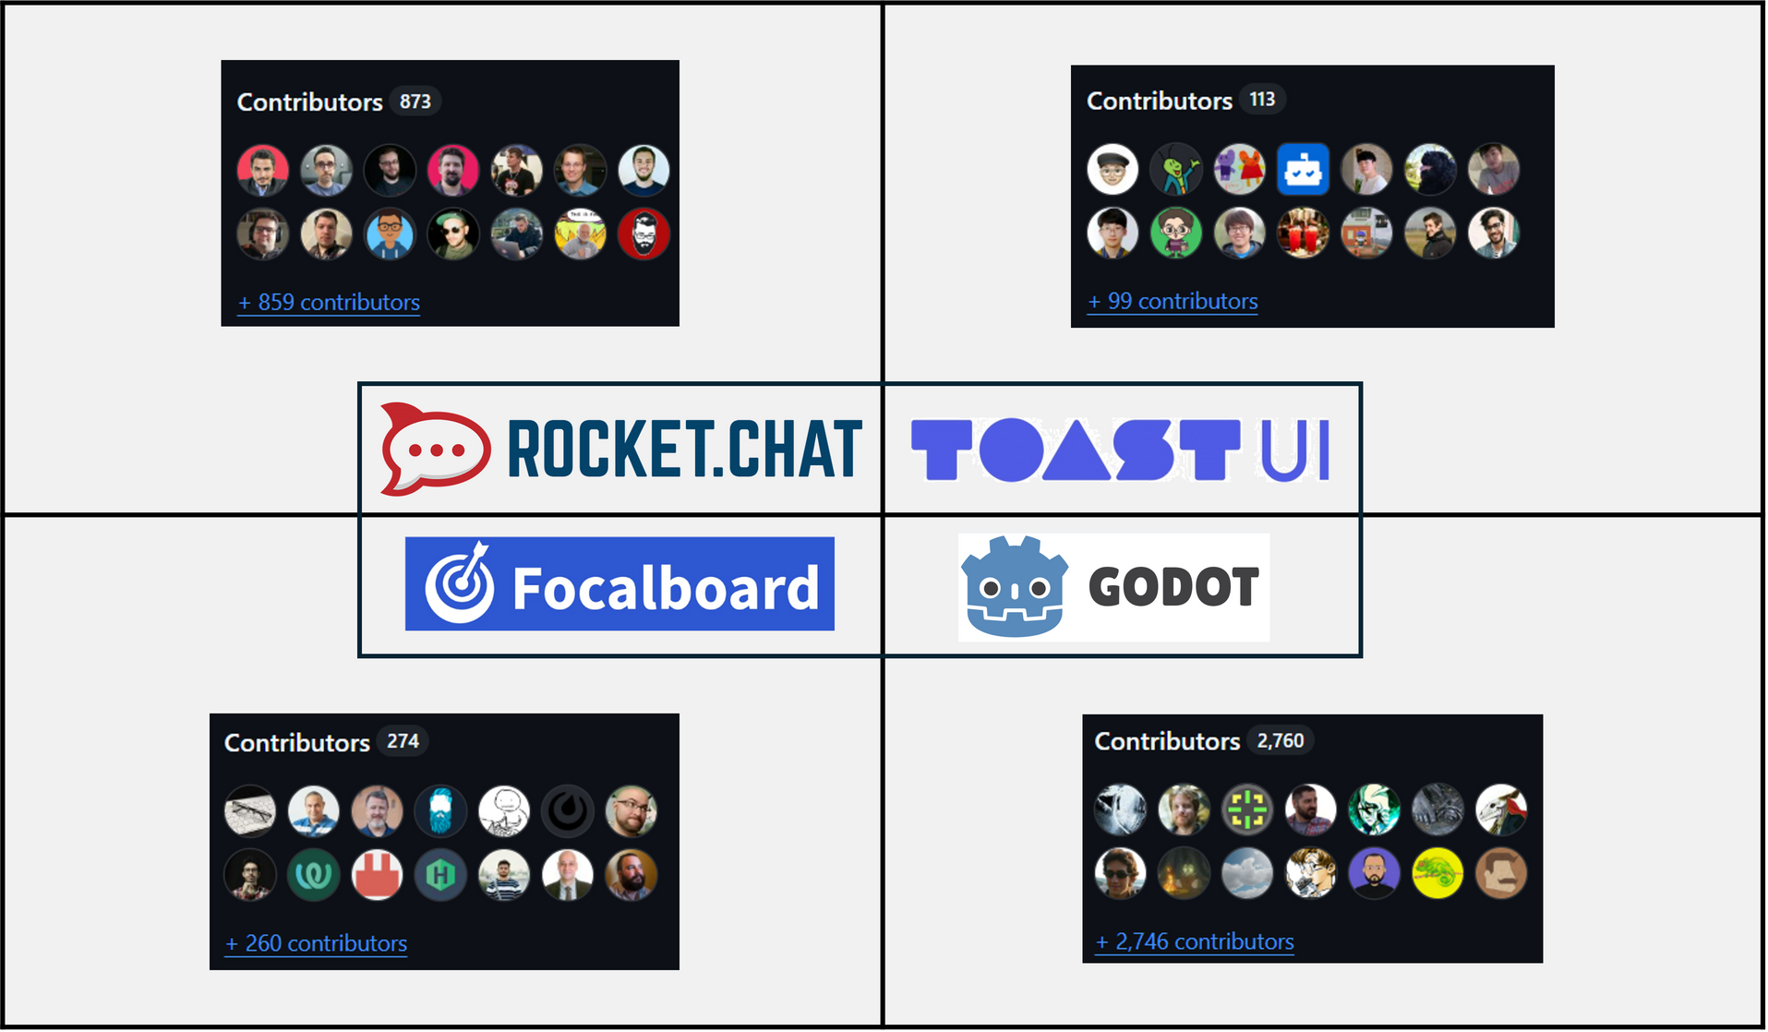
1-3. Analysis for
Community Activity
Number of Contributors

Slide 9
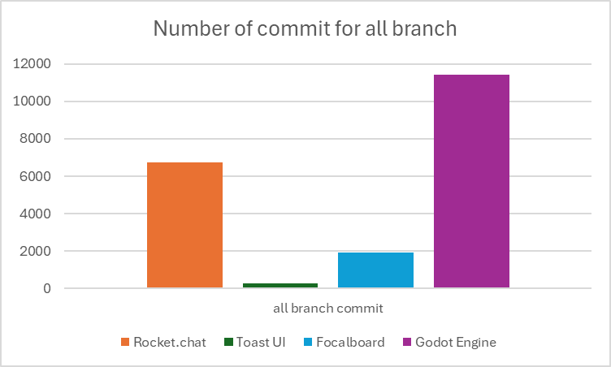
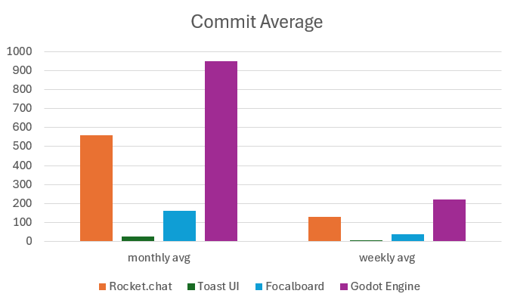
1-3. Analysis for
Community Activity
Comprehensive Comparison

Slide 10
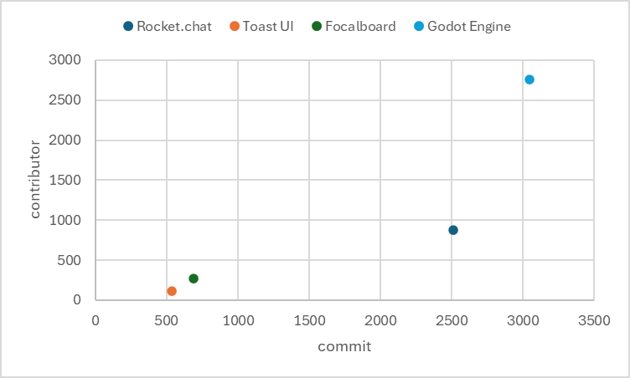
1-3. Analysis for
Community Activity
Comprehensive Comparison
Contributor ⬆️
Number of commit ⬆️

Slide 11
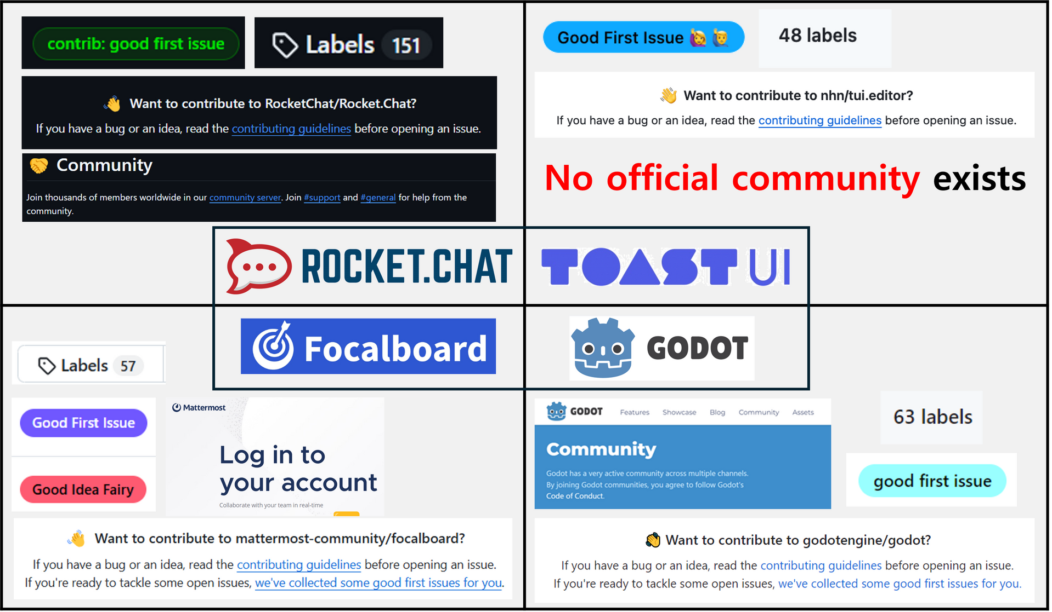
1-3. Analysis for
Inclusivity and Support
Beginner-Friendly Issues & Community

Slide 12
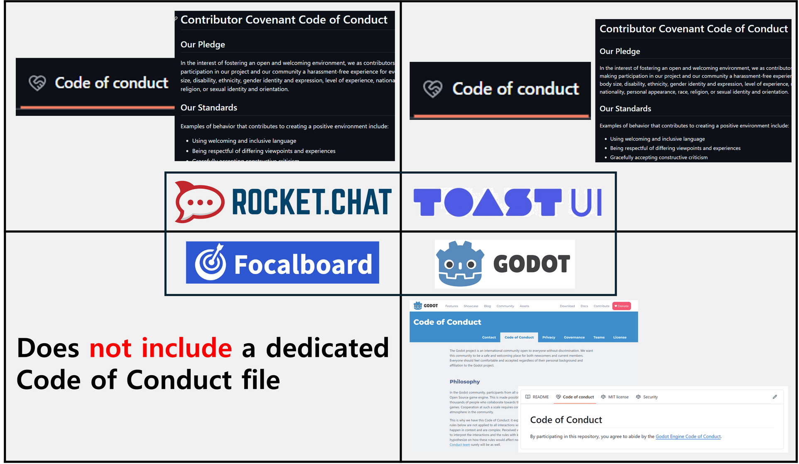
1-3. Analysis for
Inclusivity and Support
Code of Conduct

Slide 13
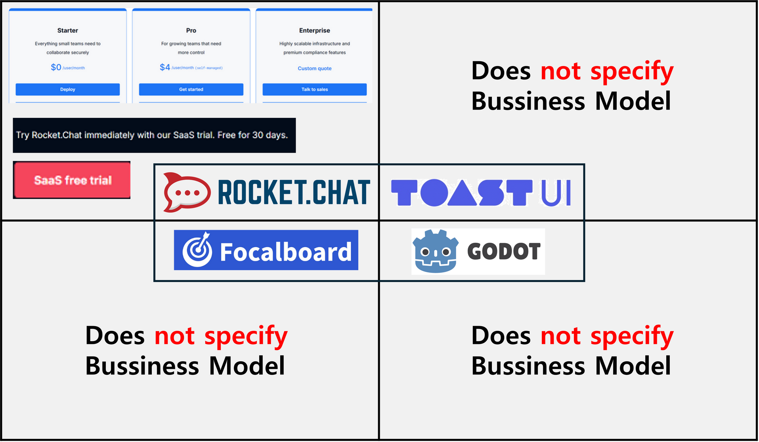
1-3. Analysis for
Commercial Orientation
Business Model

Slide 14
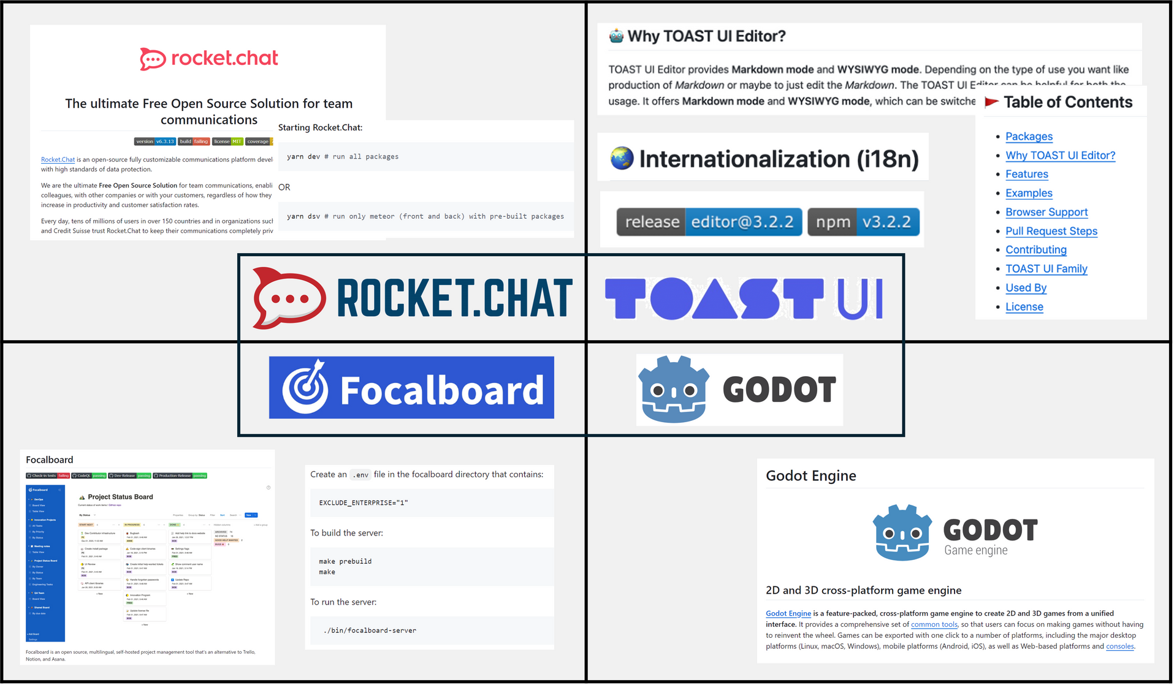
1-3. Analysis for
Documentation Quality
README.md Clarity

Slide 15
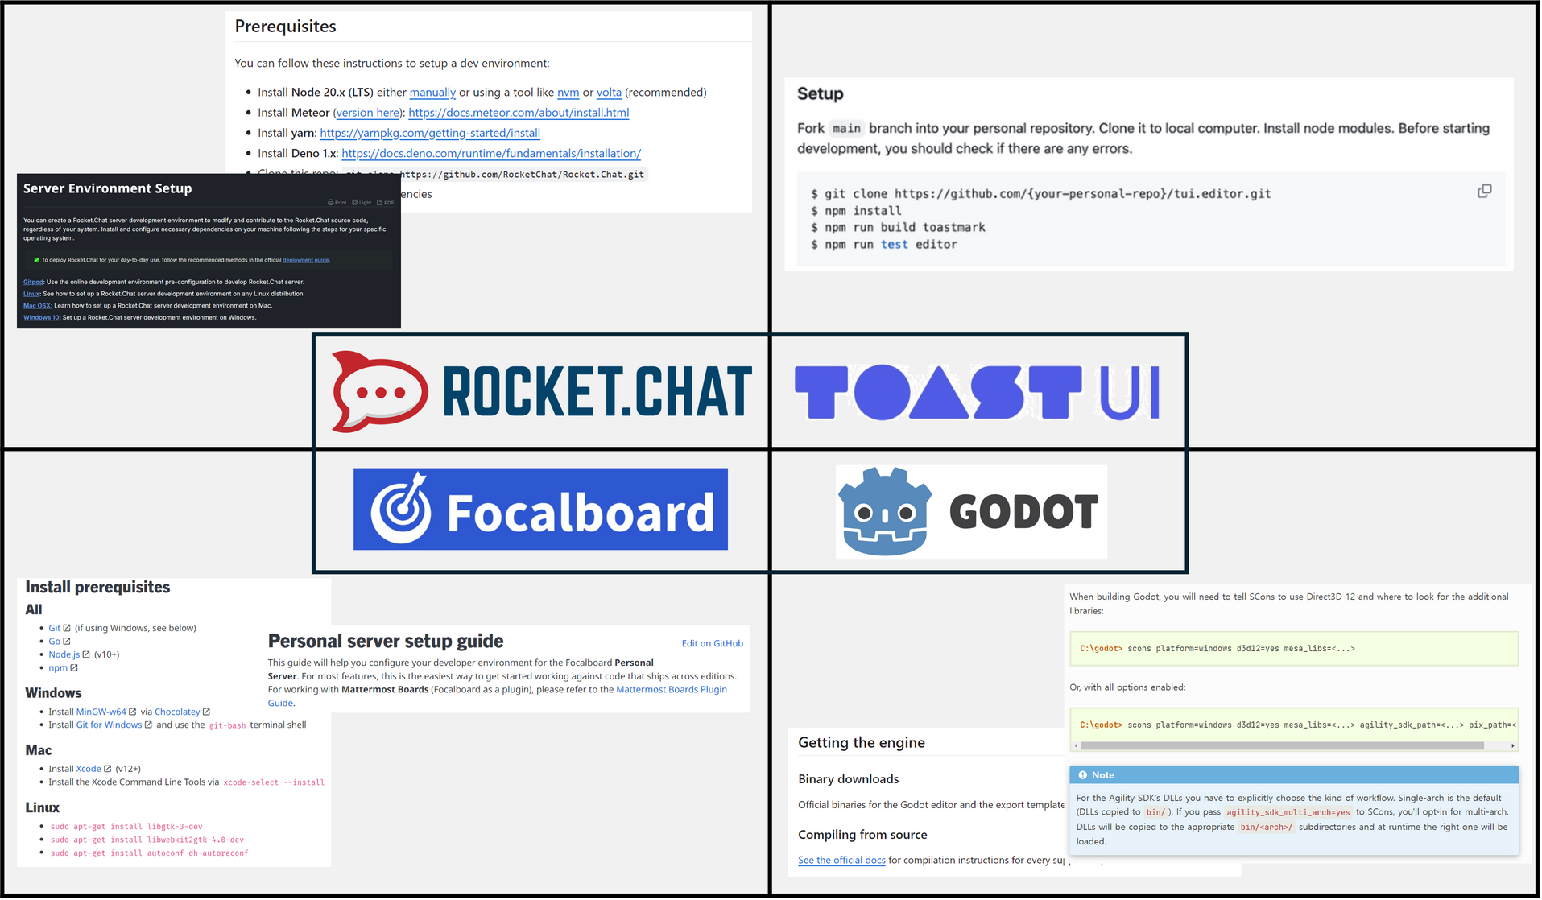
1-3. Analysis for
Documentation Quality
Initial Setup Instructions

Slide 16
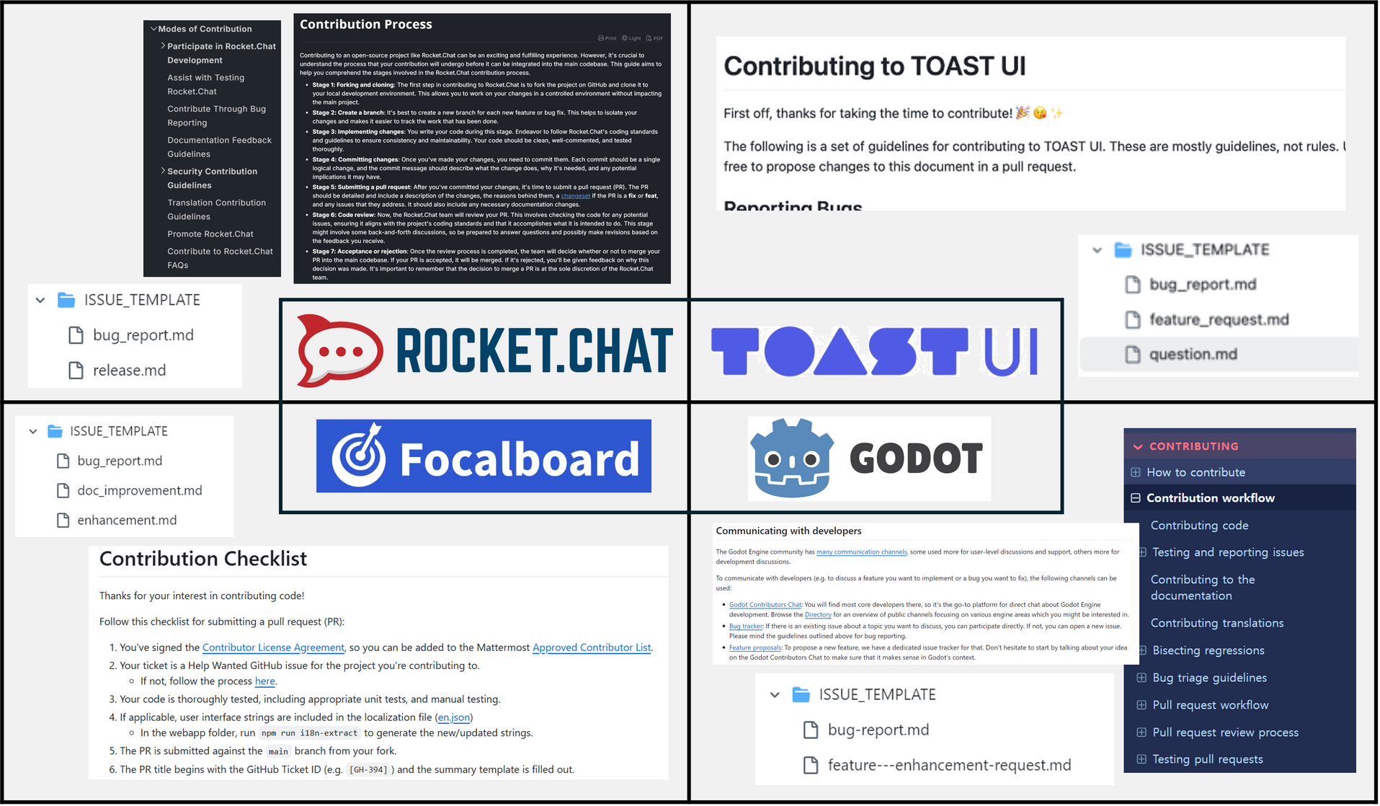
1-3. Analysis for
Documentation Quality
Contribution Guidelines

Slide 17
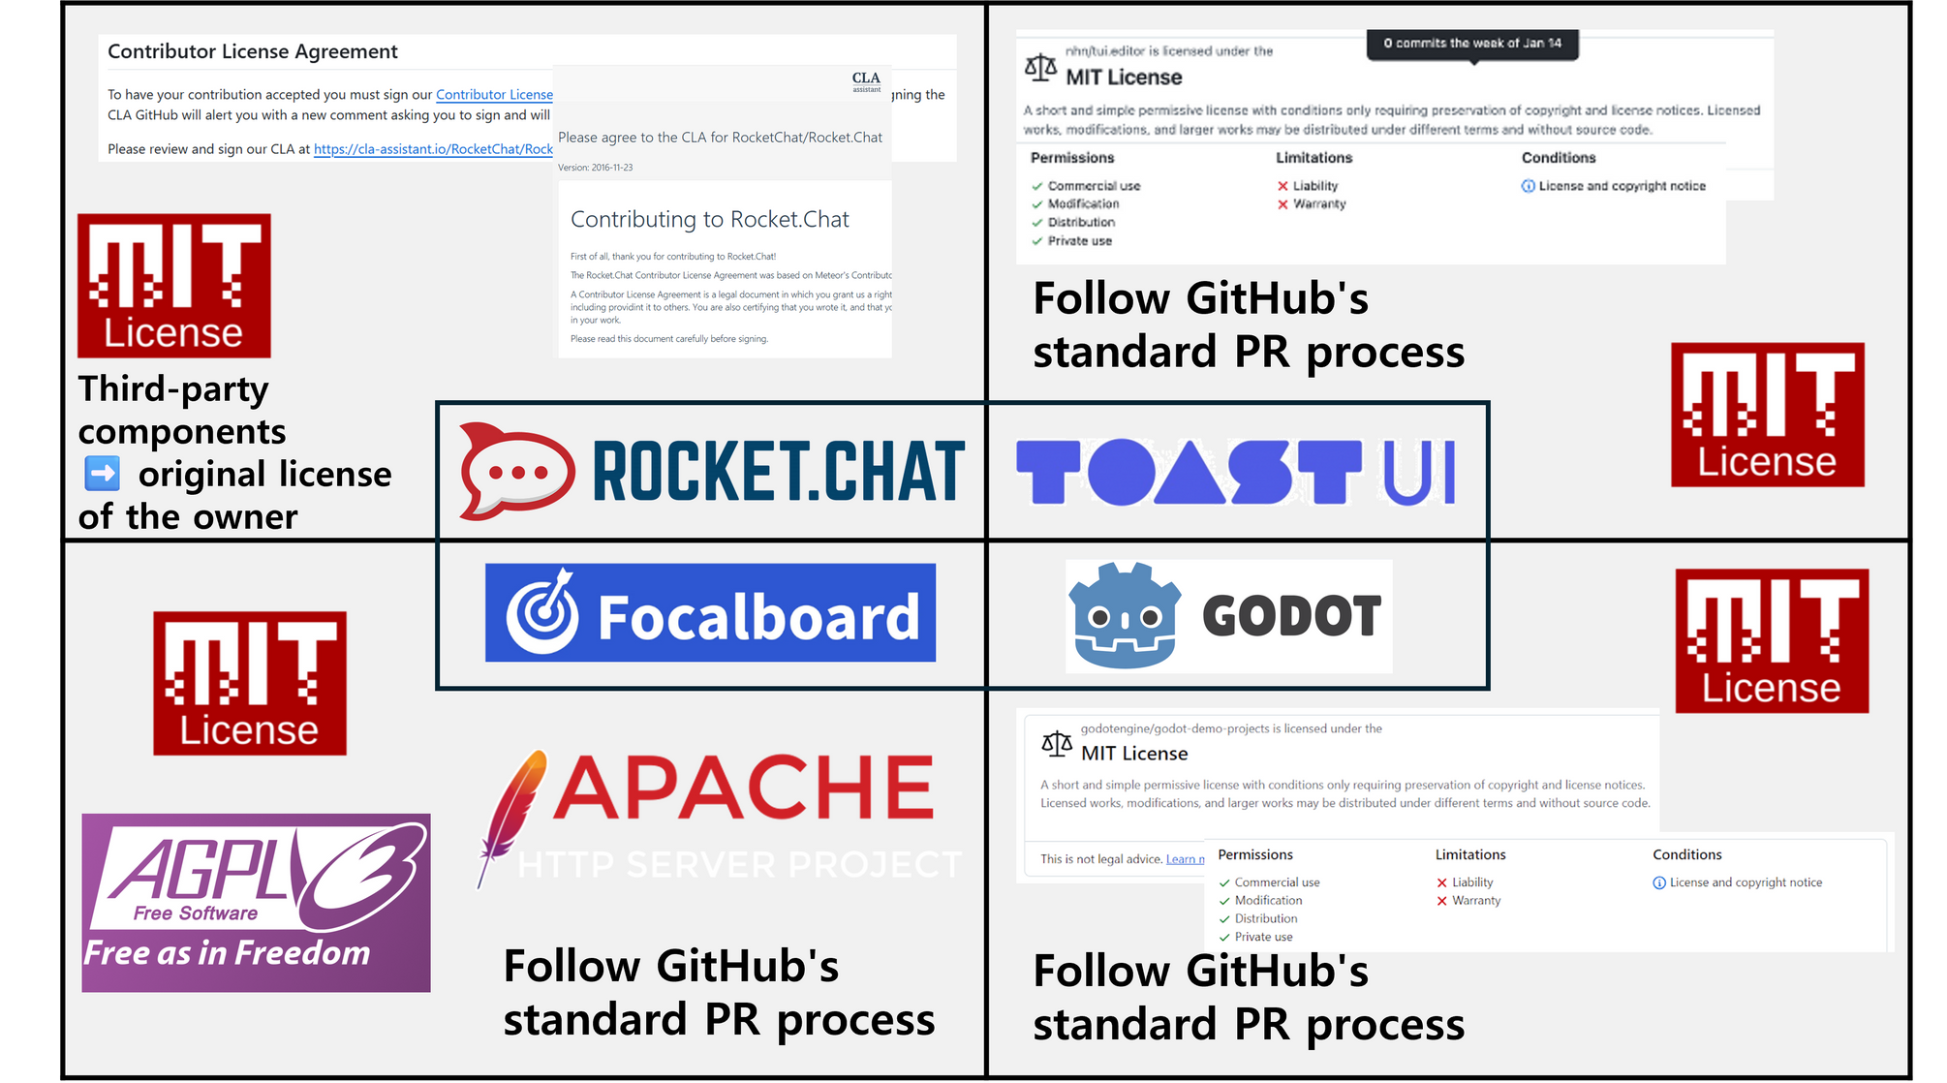
1-3. Analysis for
Licensing & CLA

Slide 18
2. Project Proposal
④ Licensing and Commercial Potential
① Introduction
IT-
MBTI
② Project Overview
⑤ Initial GitHub Setup
③ Community and Governance
⑥ ?Github

Slide 19
2-1. Introduction
Insights from OSS Community Analysis
Key Insights :
✅ Limited engagement with contributors in discussions and issue tracking
➡️ Community Dynamics
✅ Unclear decision-making process
➡️ Governance Models
✅ Lack of roadmap for scaling contributors and feature requests
➡️ Scalability and Sustainability

Slide 20

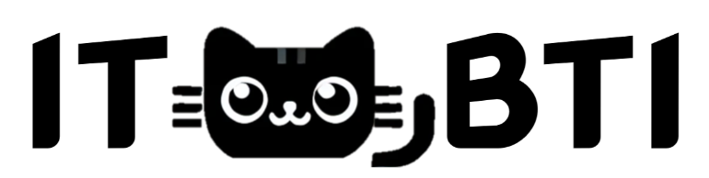



2-2. Project Overview
Philosophy
ITM students can explore their unique career traits in an easy and enjoyable way
“Understanding yourself and designing a better future!”
Cats with diverse personalities
and appearances.
Project Type
Web-based career exploration tool
: Accessible without installation, making collaboration and contribution easier
Project Name: IT-MBTI
Tech stack
: standard language for web, dynamic and responsive interfaces
: component-based structure
: modular and dynamic styling,

Slide 21
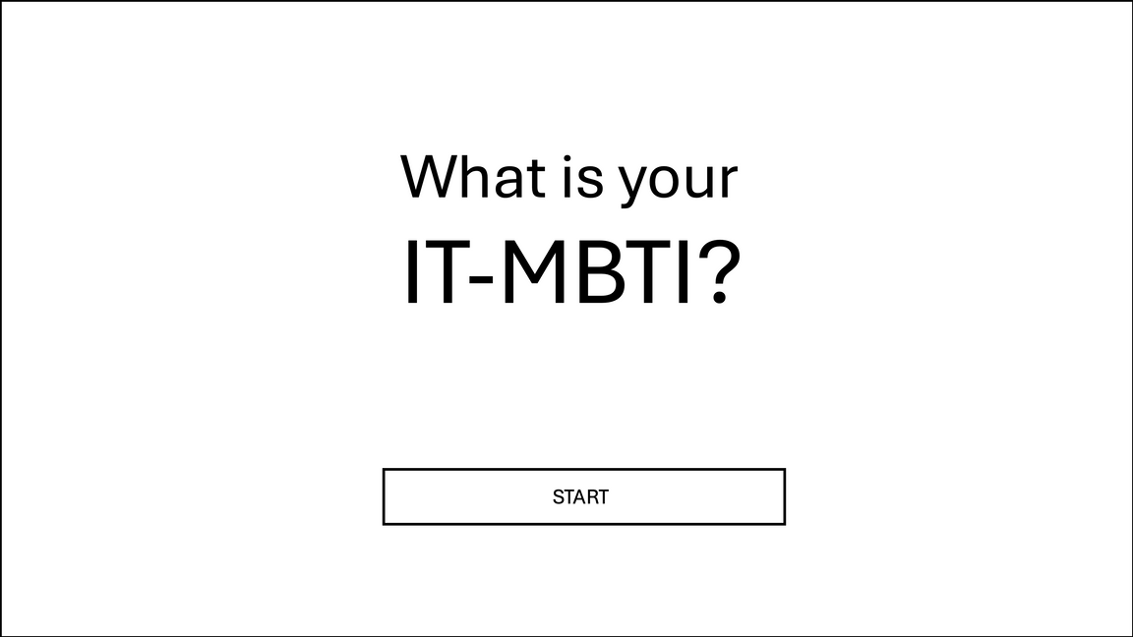
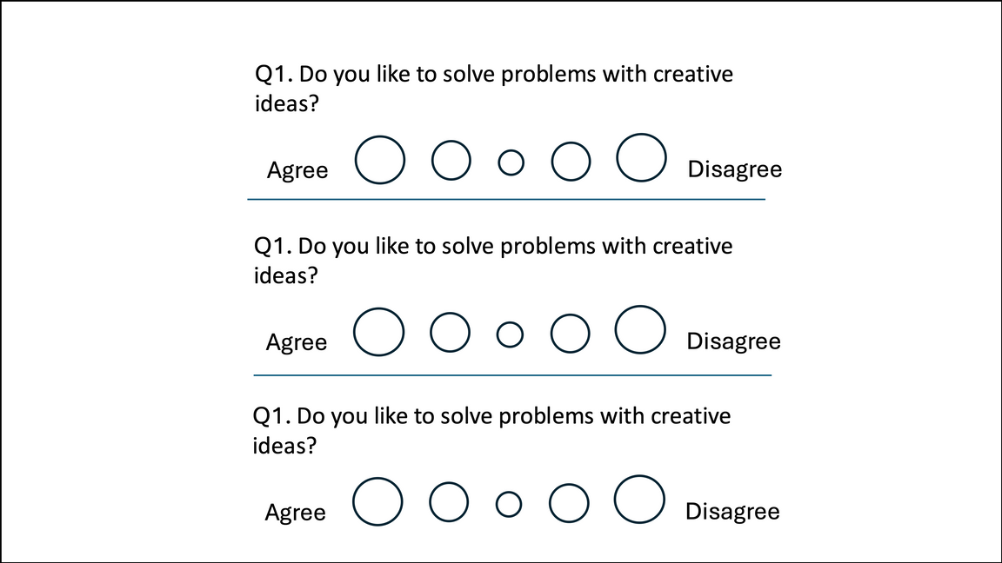
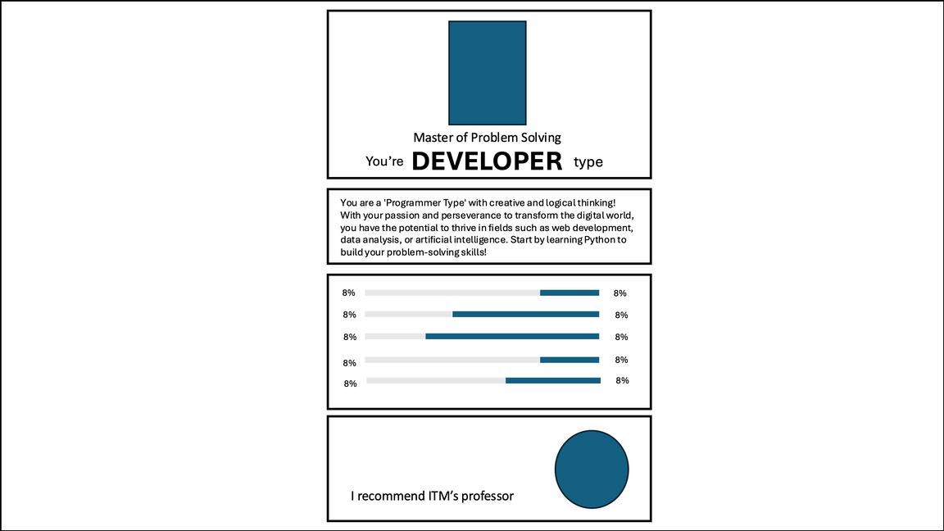
2-2. Project Overview
Features
Career Aptitude Test: Evaluate your aptitude for 7 IT career paths through specific questions.
Personalized Results: Recommend the most suitable IT career path based on your score.
Simple Question Format: Users respond on a 5-point scale to express their preferences easily.
User-Friendly Interface: Designed to be intuitive and easy for everyone to use.

Slide 22



2-3. Community and Governance
Community
Welcoming New Contributors
Operating Diverse Community Channels
Slack
Real-time communication
Github-issue
Bug tracking and management
Github-Discussions
Idea sharing and discussion
E-mail
Official inquiries and
feedback collection

Slide 23
2-3. Community and Governance
Governance
Team
Team
Community
Community
Initial Phase
Intermediate Phase
Long-Term Phase
1-6 months
Detailed Documentation
Activate GitHub Discussions
Community Feedback Collection
6-12 months
Expand Community with Early Contributors
Strengthen Collaboration
12+ months
Transition to Community-Driven Model
Introduce Optional Voting System
Assign Leadership Roles (Reviewers, Maintainers)

Slide 24
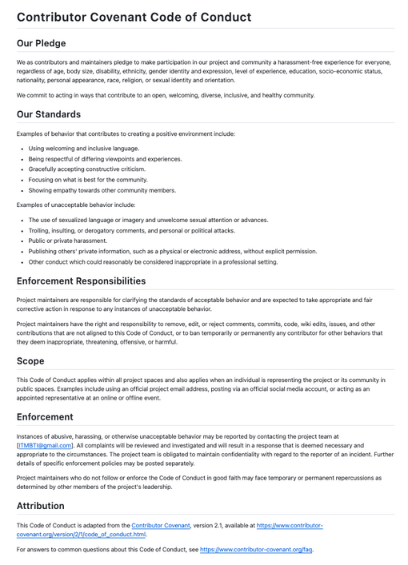
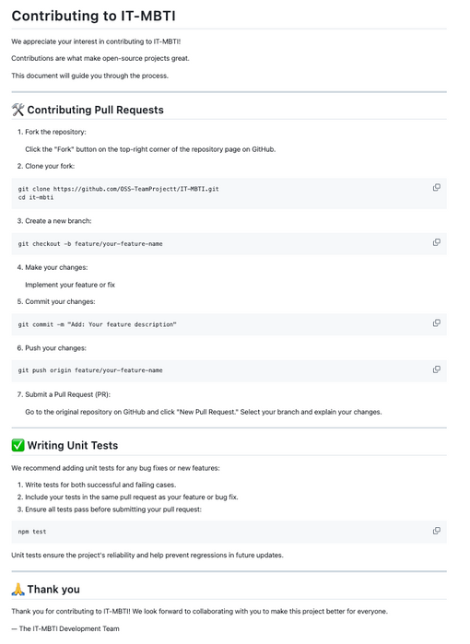
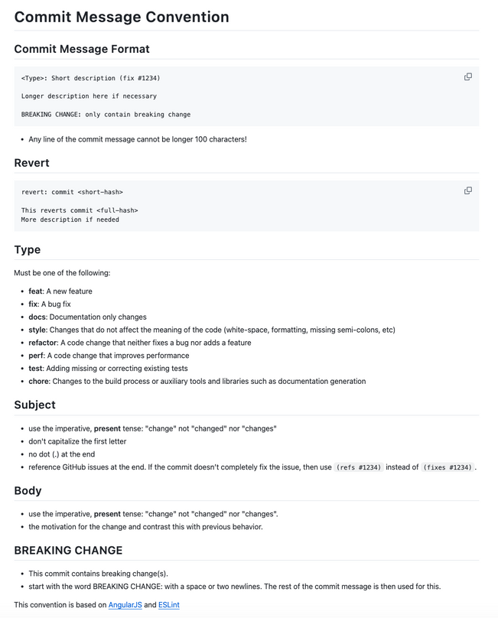
2-3. Community and Governance
documentation
CODE_OF_CONDUCT.md
CONTRIBUTING.md
COMMIT_CONVENTION.md

Slide 25

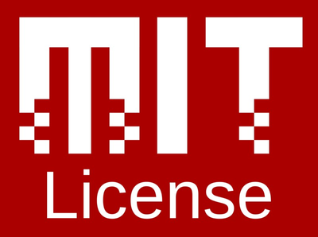
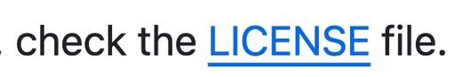
2-4. Licensing and Commercial
"IT-MBTI will remain non-commercial, free, and open for everyone."
To ensure free and unrestricted access for all students and communities.
To uphold the educational purpose of the project.
To provide freedom of use, modification, and redistribution
MIT License
The MIT License aligns with our commitment to openness and accessibility
"Encourages broader adoption and adaptation by making the project as flexible as possible."
<- Our project contains a license file

Slide 26
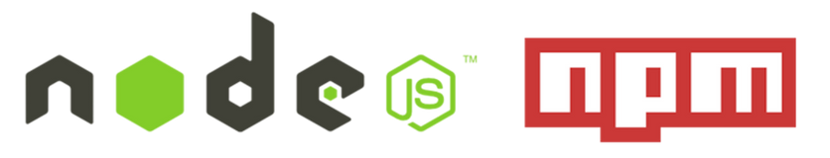

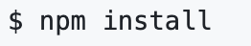
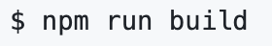
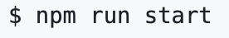
2-5. Initial GitHub Setup
1.Clone the Repository
2.Navigate to the Project
Node.js
3.Install Dependencies
: Fast and Efficient Development Environment
npm
4.Build the Project
: easy management and installation of dependencies required for the IT-MBTI project.
5.Start the Application

Slide 27

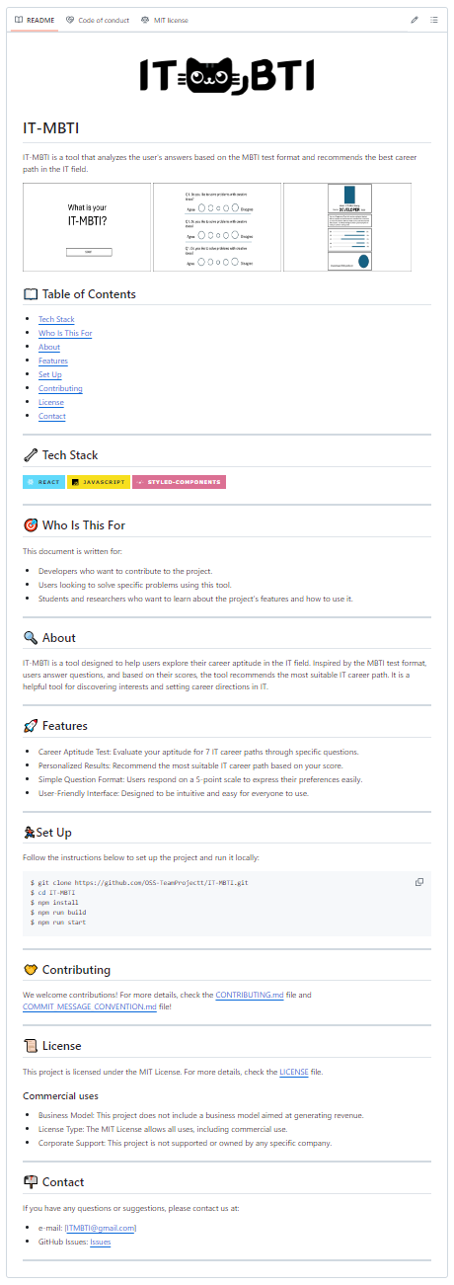
2-6. Our GitHub
Link
Project Introduction
Overview
Table of Contents
Tech Stack
Who Is This For
About
Features
Set Up
Contributing
License
Contact

Slide 28
Q & A

Slide 29
Thank you
for listening

